Slide 1
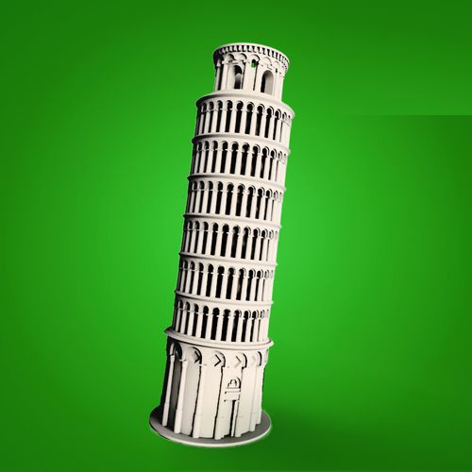
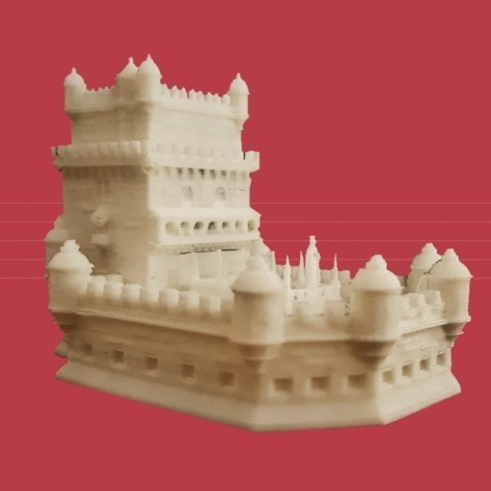
L.1_Cultural Heritage Classification

Slide 2
Outline
Learning Objective
Definition of Cultural Heritage (concept & classification)
The cases of Greece, Italy & Portugal
Points to Remember
Activities
Videos

Slide 3
Learning Objective
At the end of this course, students will be able to:
Understand the Cultural Heritage concept
Distinguish the difference between Cultural Heritage and Monument
Recognize all types of heritage:
- Tangible heritage (Movable, immovable monuments)
- Intangible heritage
- Natural heritage
Single out and group different types of heritage
Provide examples of different types of heritage in their country (6-11)

Slide 4
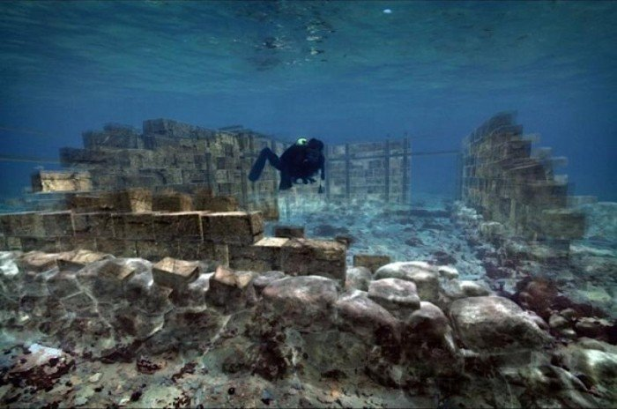
Cultural Heritage Definition
Heritage is our legacy from the past, what we live with today, and what we pass on to future generations. Our cultural and natural heritage are both irreplaceable sources of life and inspiration.
* Cultural Heritage ≠ Monument
Pavlopetri, Lakonia, Greece

Slide 5
Cultural Heritage of Greece
TANGIBLE IMMOVABLE
Palestra, Ancient Olympia
Ancient Theater of Epidaurus
Temple of Poseidon, Sounion
Molivos
Castle,
Lesvos
Knossos,
Crete

Slide 6
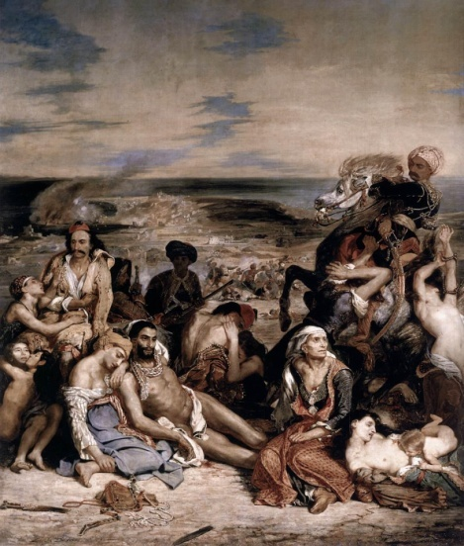
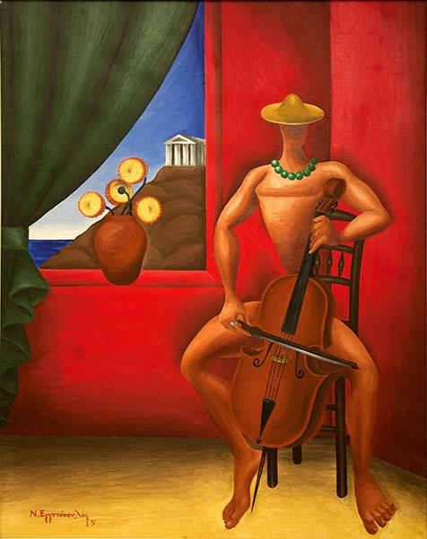
Cultural Heritage of Greece
TANGIBLE MOVABLE
The massacre of Chios
by Eugène Delacroix
Violin player
by Nick Eggonopoulos
Mytilene by Theofilos

Slide 7
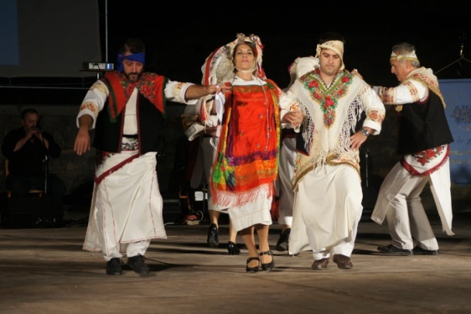
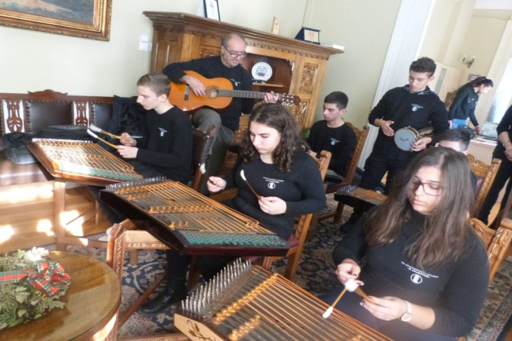
Cultural Heritage of Greece
INTANGIBLE
Τraditional music by “Santouri”, Lesvos
Melekouni, Rhodes
Traditional dance
of Pyrgousikos, Chios
Gaitanaki
Handmade
flower wreath
at the 1st day of May
https://www.youtube.com/watch?v=0wpTPyUCA3s (1:30)

Slide 8
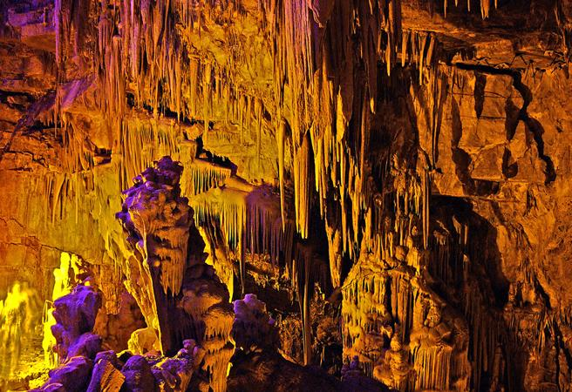
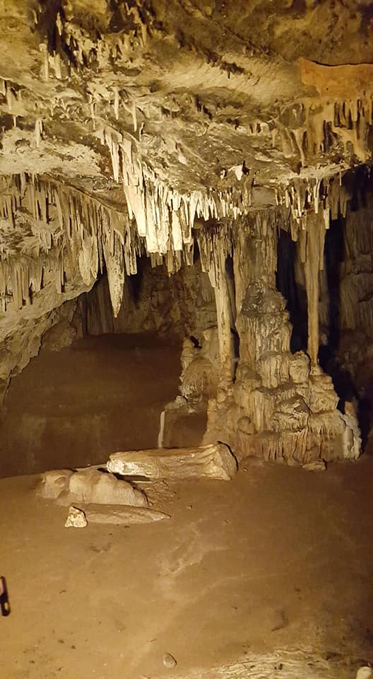
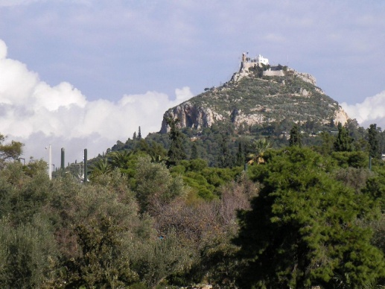
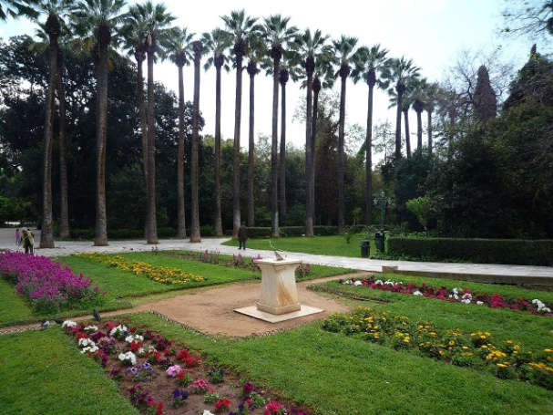
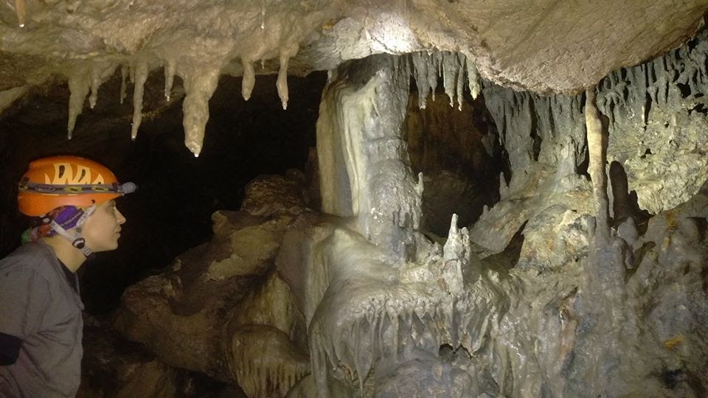
Cultural Heritage of Greece
Lycabettus,
Athens
NATURAL
Cave of Olympi, Chios
National Garden,
Athens
Koumelo cave, Rhodes
St. George cave, Lesvos

Slide 9
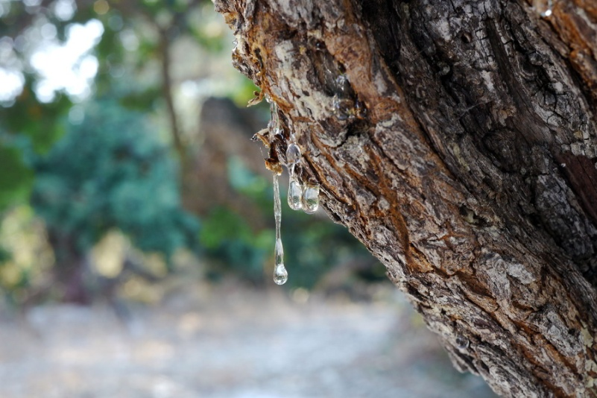
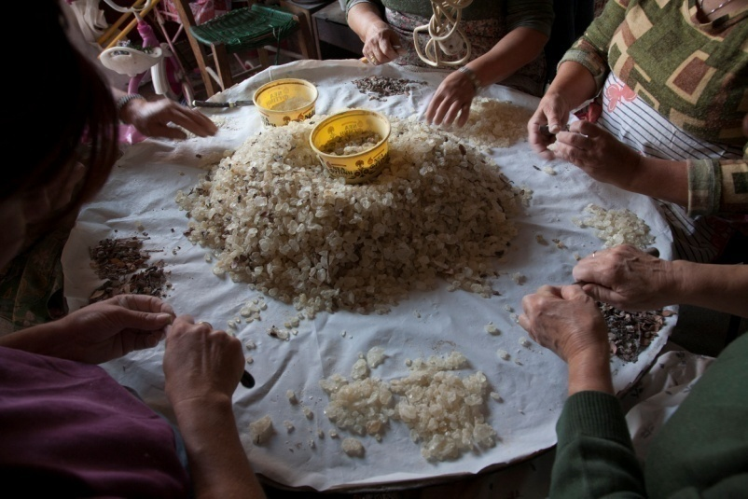
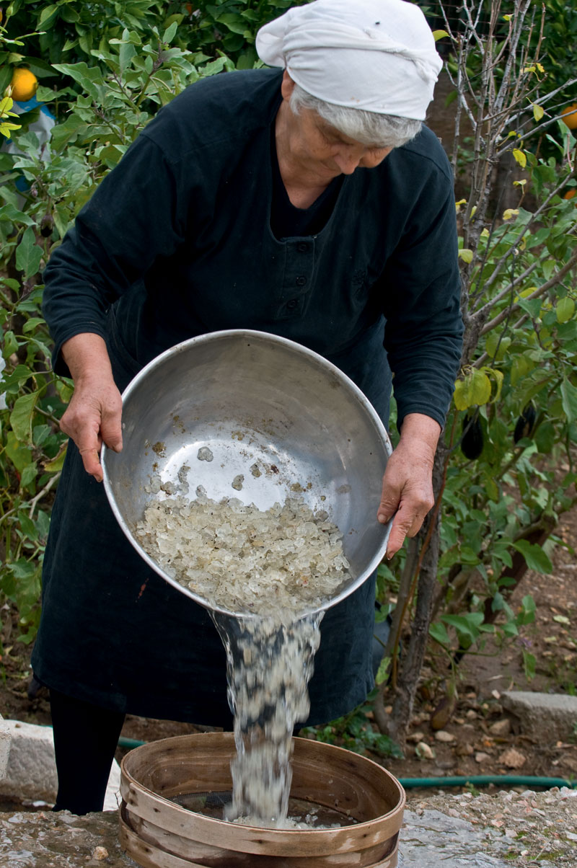
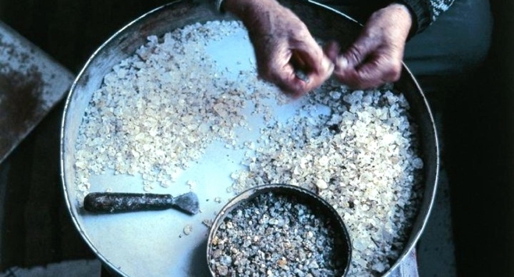
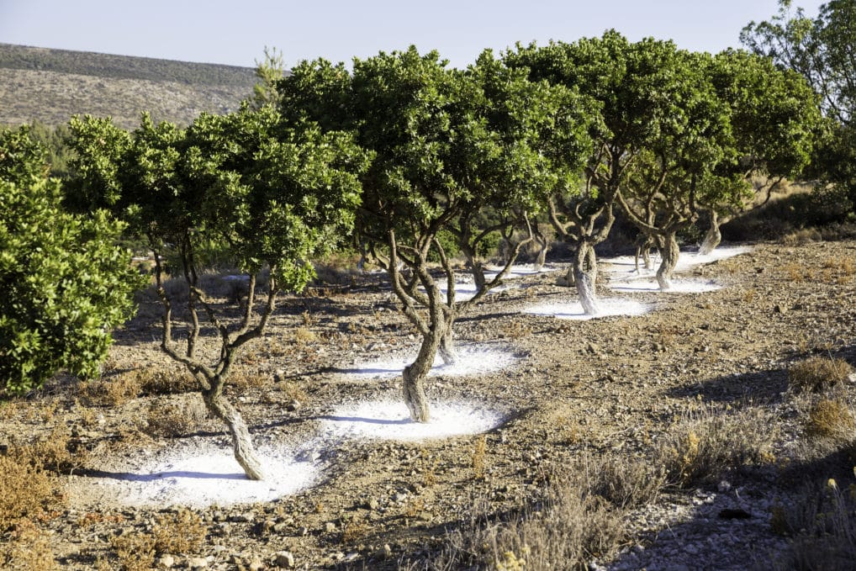

Slide 10
Cultural Heritage of Italy
TANGIBLE IMMOVABLE
Pisa Tower
Colosseum of Rome
Milan Cathedral
Nuraghe
of Barumini
Segesta Temple

Slide 11
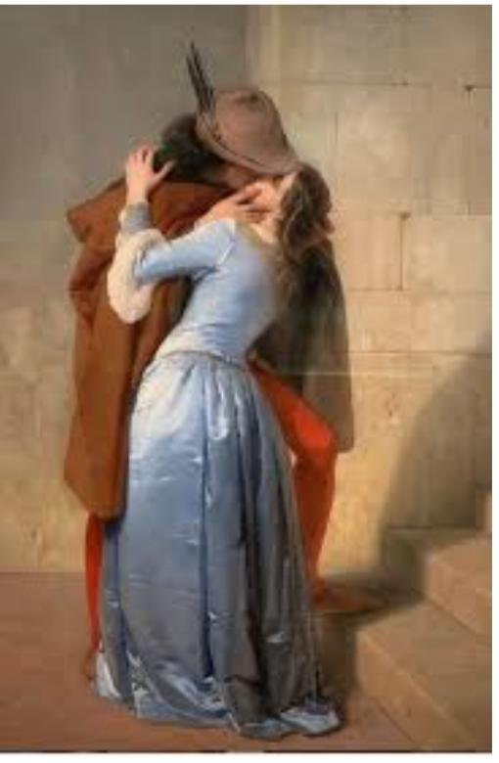
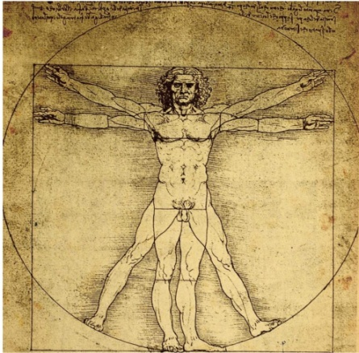
Cultural Heritage of Italy
TANGIBLE MOVABLE
Vitruvian Man, Leonardo da Vinci
The Kiss, Francesco Hayez
Galileo Galilei's Telescope

Slide 12
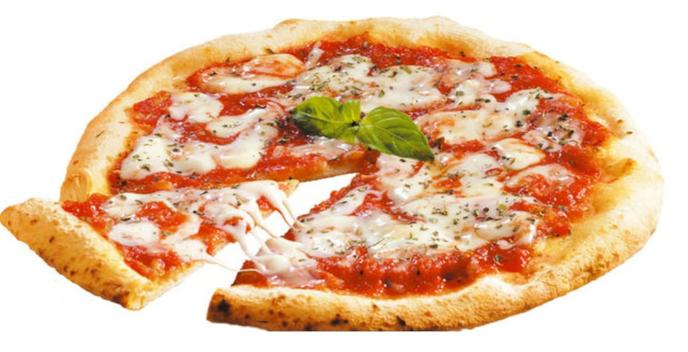
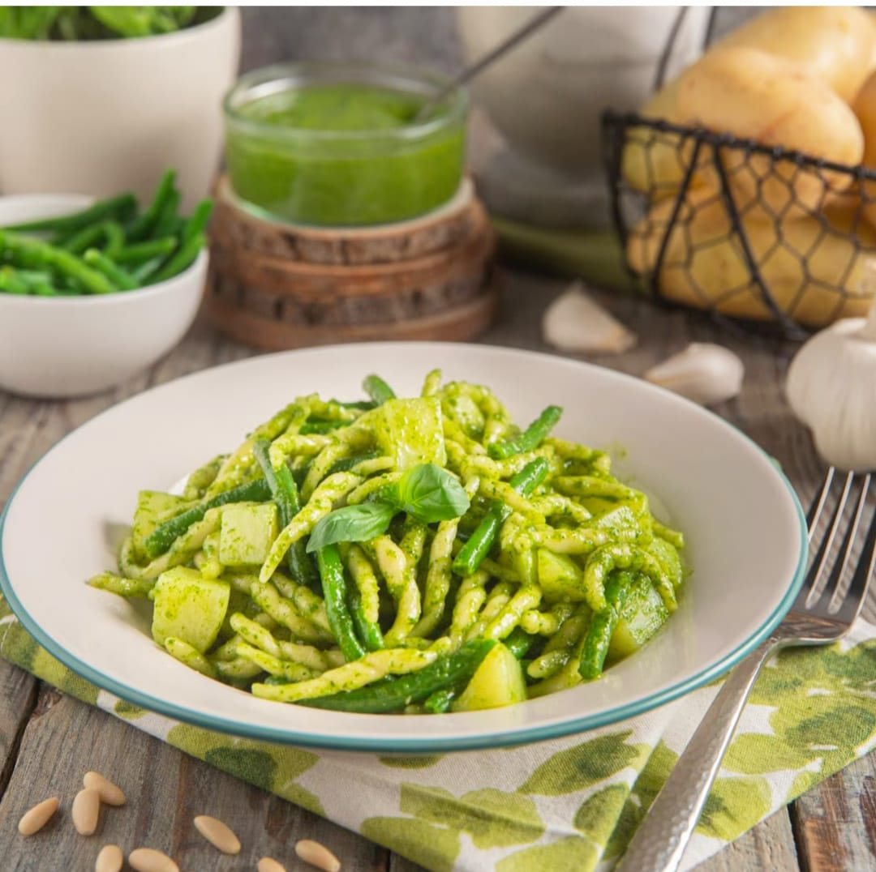
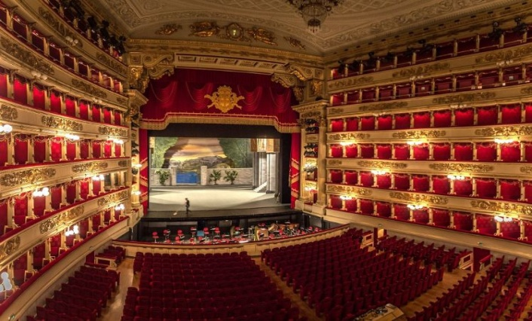
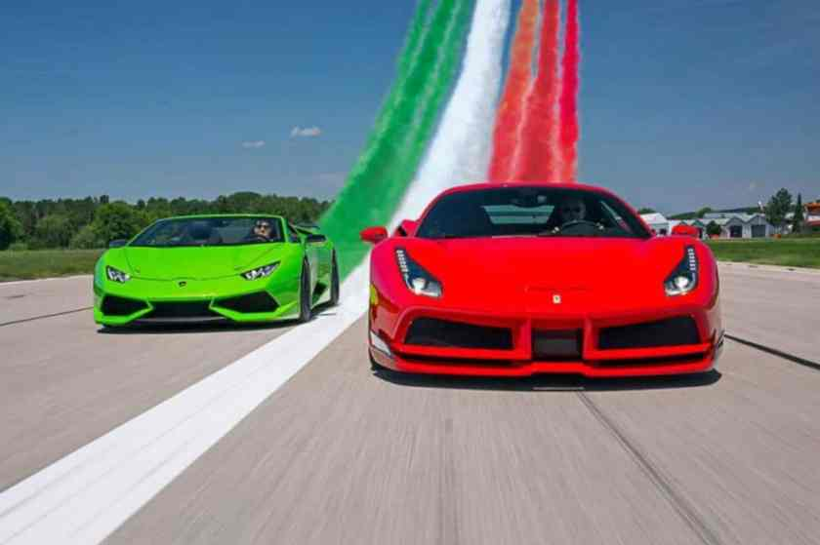
Cultural Heritage of Italy
INTANGIBLE
Pizza
Farinata
Pasta al pesto
Ferrari brand
Opera Teatro-alla-scala

Slide 13
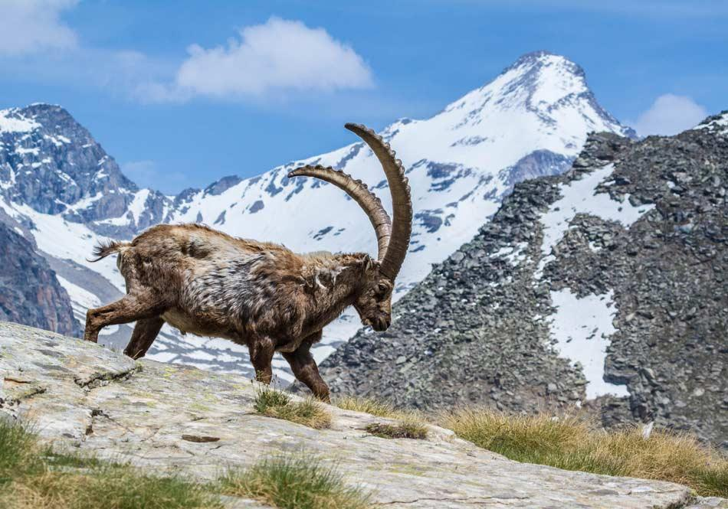
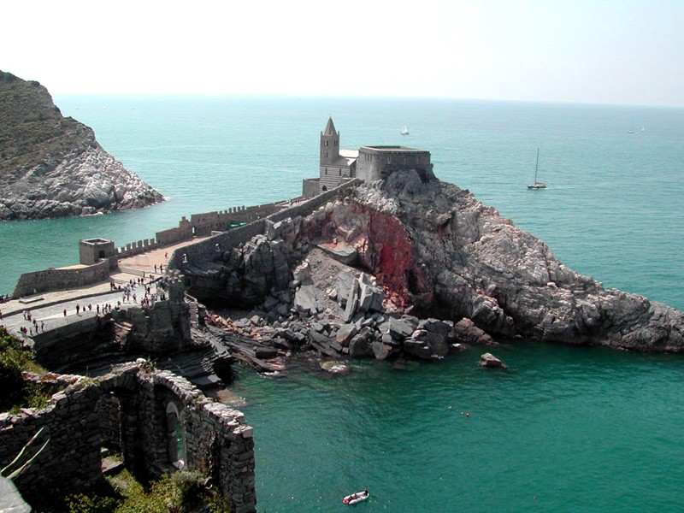
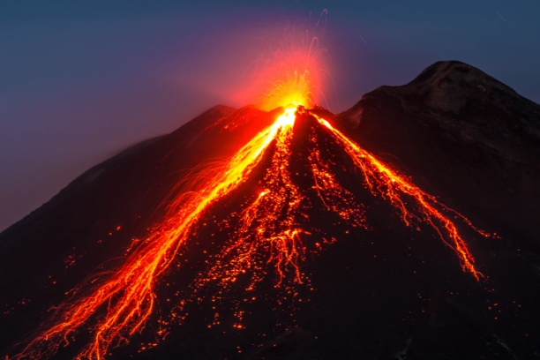
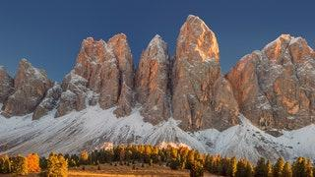
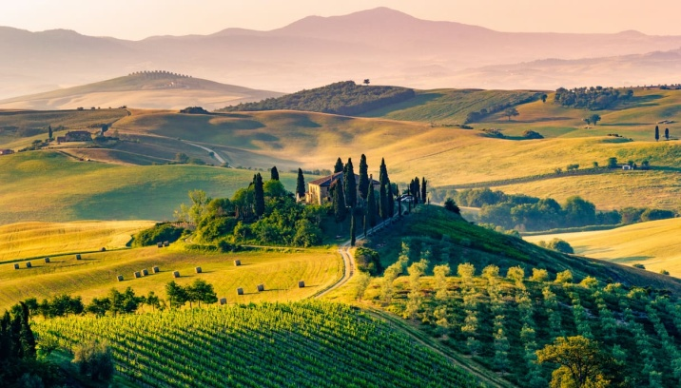
Cultural Heritage of Italy
NATURAL
National Park of Gran Paradiso
Portovenere
Volcano Etna
Dolomiti
Val d‘ Orcia

Slide 14
Cultural Heritage of Portugal
Torre de Belém
Templo Romano de Évora
Padrão dos Descobrimentos
TANGIBLE IMMOVABLE
Mosteiro
de Santa Maria
da Vitória
Castelo de Guimarães

Slide 15
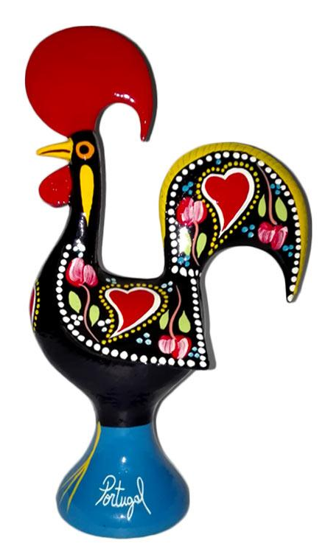
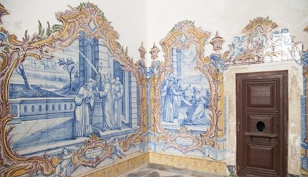
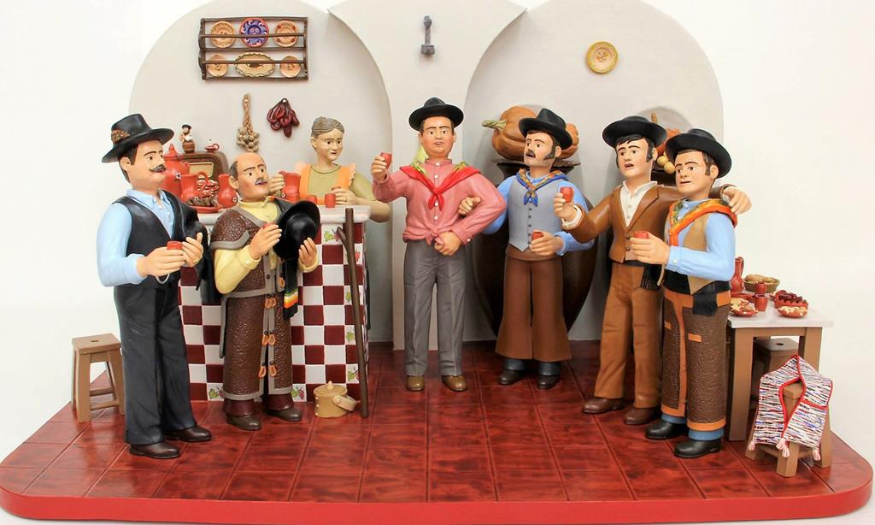
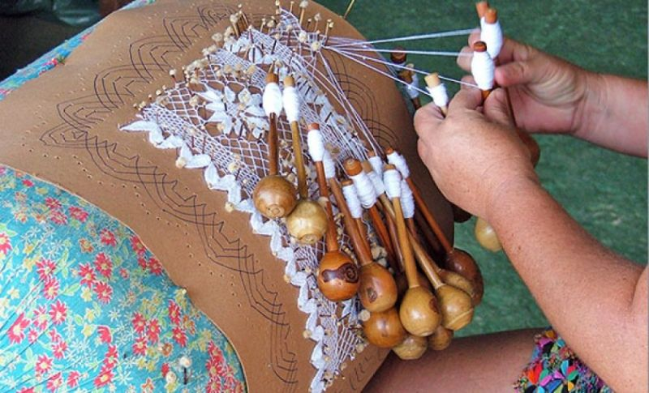
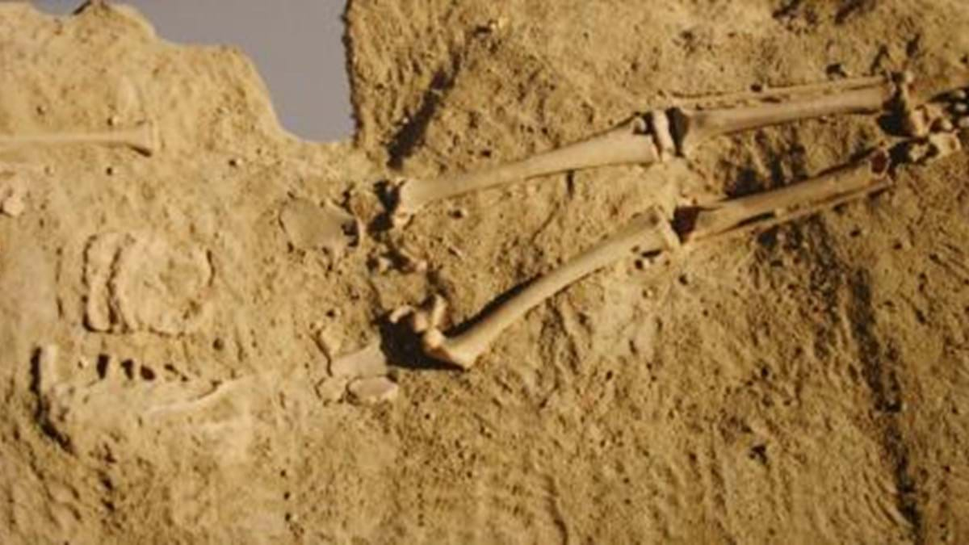
Cultural Heritage of Portugal
Clay figures
of Estremoz
Azulejos
TANGIBLE MOVABLE
Renda de bilros
Lapedo
child
Rooster
of Barcelos
https://www.youtube.com/watch?v=Bcno9Cz_xzs

Slide 16
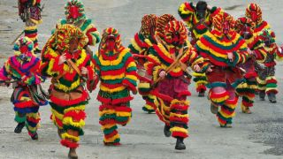
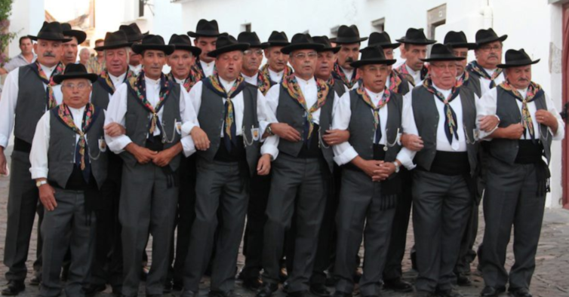
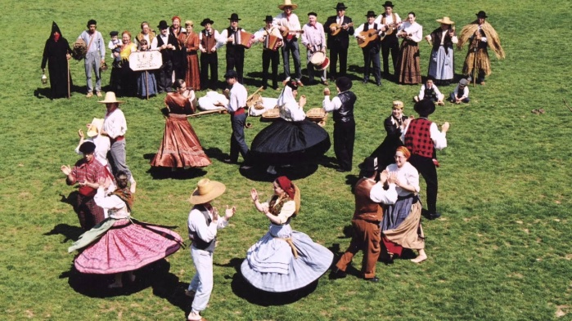
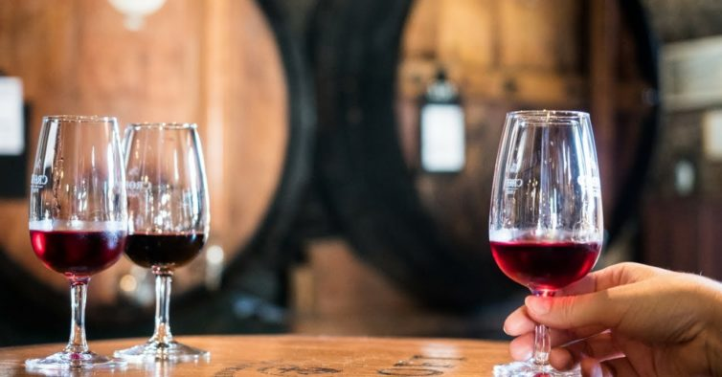
Cultural Heritage of Portugal
INTANGIBLE
Fado
Carnival of Podence
Cante alentejano
https://www.youtube.com/watch?v=_Pn53uSYwOM
Folklore
Porto wine

Slide 17
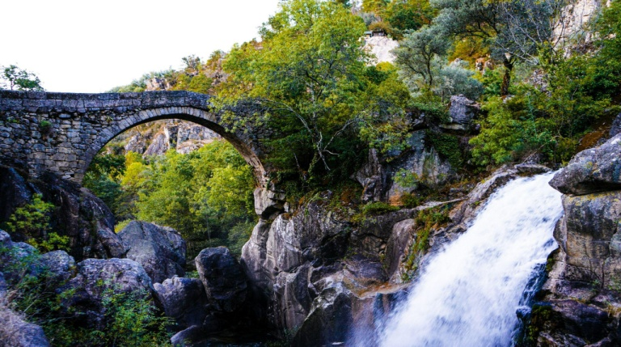
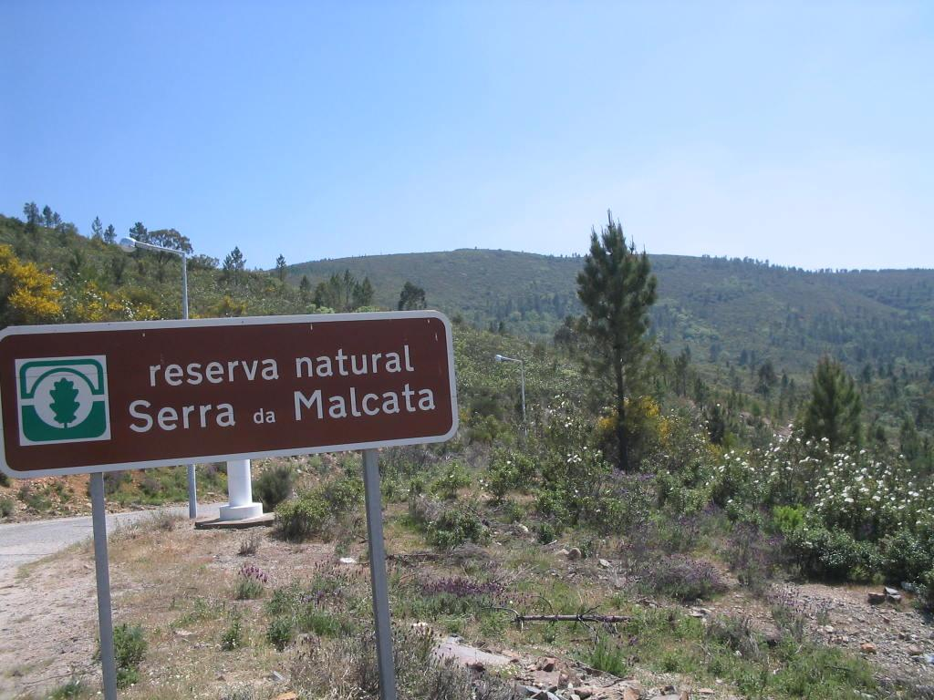
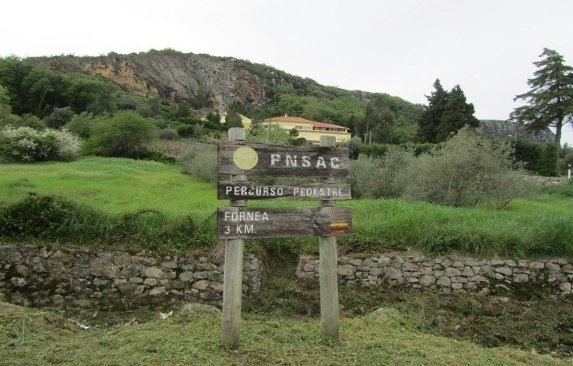
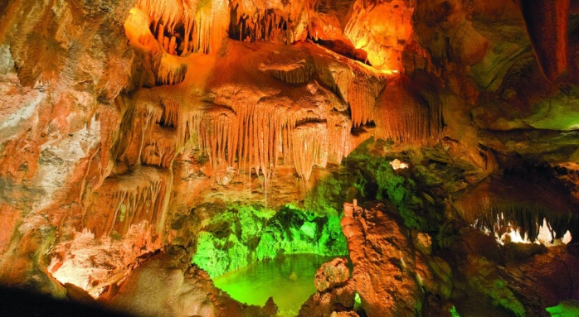
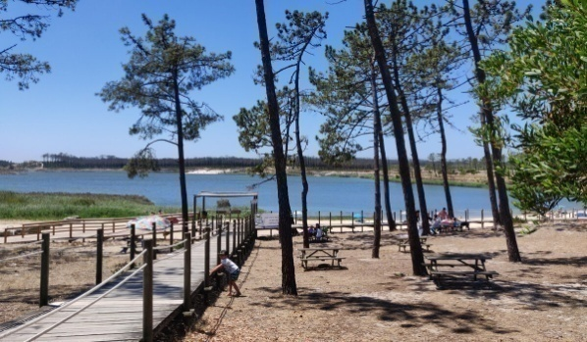
Cultural Heritage of Portugal
NATURAL
National Park of Peneda-Gerês
Natural Reserve of Serra da Malcata
Natural Park of Serras
de Aire e Candeeiros
Caves of
Mira de Aire
Ervedeira Lake

Slide 18
REMEMBER
Cultural Heritage is the chain between the past, the present and the future
Cultural Heritage is grouped into Tangible, Intangible and Natural
Tangible Cultural Heritage is grouped into Movable, Immovable and Underwater
Cultural Heritage ≠ Monuments

Slide 19
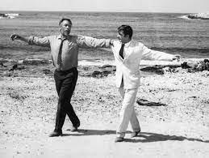
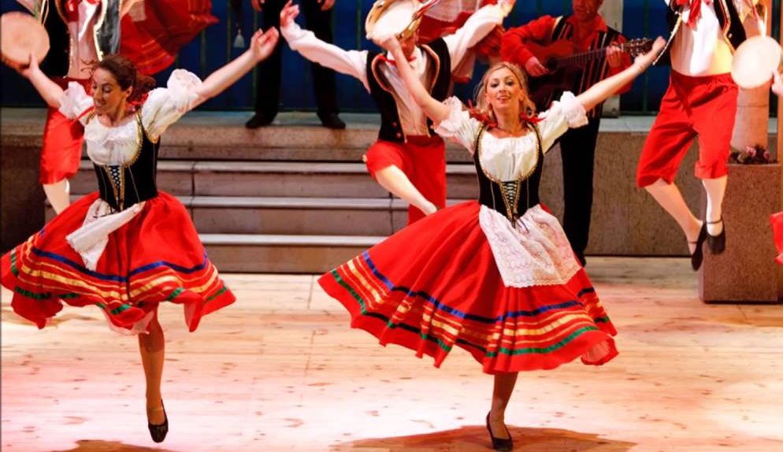
ACTIVITY 1
KINDERGARTEN & PRIMARY SCHOOL
Separate the students into small groups (2-4 persons), make them sit in a circle, and play each country’s traditional music.
Afterwards, try to show them the exact steps for each dance
https://www.youtube.com/watch?v=QskFT7AaKH0
https://www.youtube.com/watch?v=S32jsMzsjJE
https://www.youtube.com/watch?v=43OOyCGbPJg

Slide 20
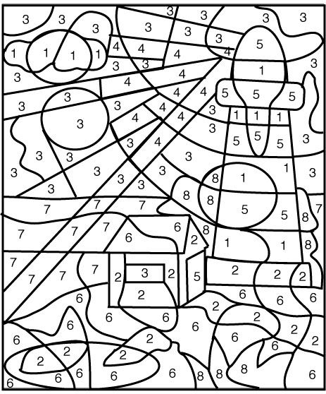
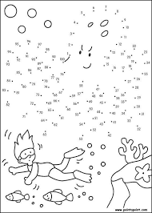
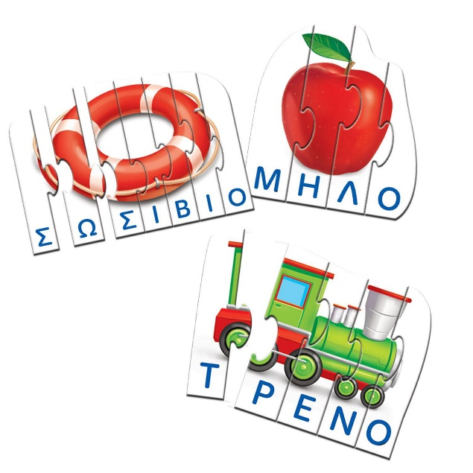
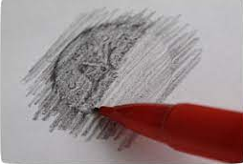
ACTIVITY 2
KINDERGARTEN
Word Puzzle
Color by numbers
Connect the Dots
Image tracing
* Use 3D Pens

Slide 21
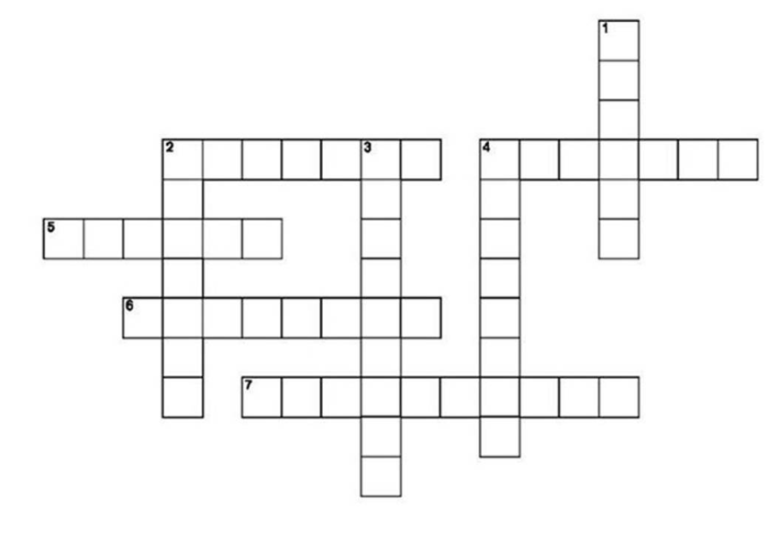
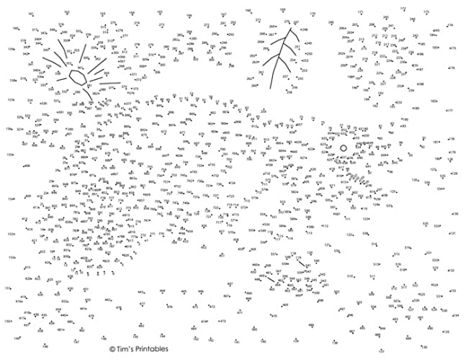
ACTIVITY 2
PRIMARY SCHOOL
Optical Drawing Projector
Crossword
Connect the Dots
Puzzles
Color by numbers

Slide 22
ACTIVITY 3
KINDERGARTEN & PRIMARY SCHOOL
Creative collage
To identify and stand out cultural heritage
To circle and cut the images’ outline
To classify tangible, intangible and natural
To glue on a canvas to create an artefact
To develop a story
To present the story to classmates
https://mericherry.com/2014/09/10/collage-process-art-kids/

Slide 23
ACTIVITY 4
KINDERGARTEN & PRIMARY SCHOOL
Wheel of Fortune
To 3D print the wheel
To select activities (song, pantomime, quiz)
To spin the wheel
To complete the task
TIP: Play online!
https://pickerwheel.com/
https://www.thingiverse.com/thing:4972053

Slide 24
ACTIVITY 5
KINDERGARTEN & PRIMARY SCHOOL
Cards Game
To 3D print the card box
To decide single-level or multi-level game
To pick up a card
To identify the category
To classify the selected card
(*for primary school pupils)
To put the card in the correct place
TIP: Play outdoors Relay race
KINDERGARTEN
https://www.thingiverse.com/thing:2797008
PRIMARY SCHOOL

Slide 25
PRINT
KINDERGARTEN & PRIMARY SCHOOL
Print different types of cultural heritage
NATURAL
Vesuvius.STL
TANGIBLE
BuiLeaning_Tower_of_Pisa.stl
All .stl files at folder “O2_ L.1”
INTANGIBLE
vegpizza.stl

Slide 26
Videos
https://www.youtube.com/watch?v=2phs0pQIgWU
https://www.youtube.com/watch?v=-h12TXJXWlM

